Slide 1

Robotics Task

Slide 2
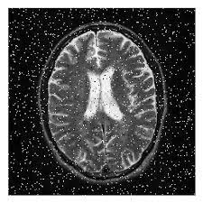
Task 1.1:
Using OpenCV, apply the appropriate blurring method on the following image, then show the original and blurred images.

Slide 3
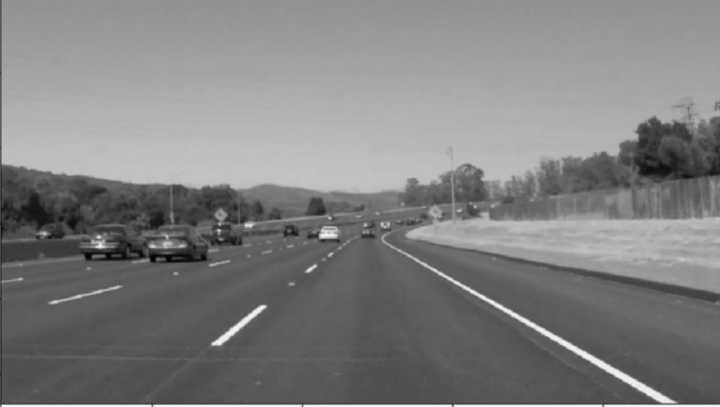
Task 1.2:
Using OpenCV, apply canny edge detector on the following image, then show the original image and the result.

Slide 4
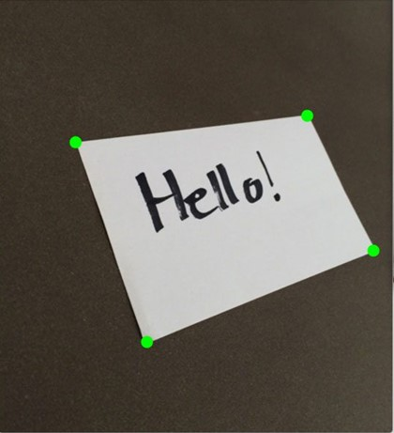
Task 1.3:
Using OpenCV, apply perspective transformation on the following image, then show the original and the transformed images.

Slide 5
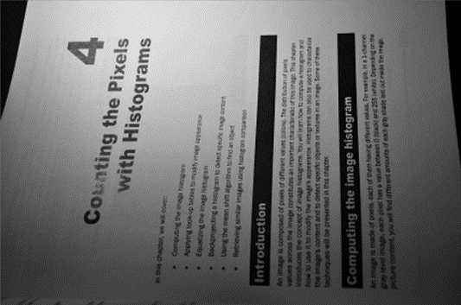
Task 1.4:
Using OpenCV, apply simple thresholding and adaptive thresholding on the following image, then show the original image and the results.

Slide 6

Task 1.5:
Using OpenCV, apply Kalman filter on the following video, to track and predict the trajectory of the red car, then display the video with the predicted trajectory.

